Slide 1
BigMart Sales
Analytics
DATA ANALYSIS AND VISUALIZATION PROJECT
From raw retail data to predictive models and interactive dashboards
KNIME for cleaning and modeling · Tableau for visualization
Notes:
Introduce the project: we took the BigMart sales dataset, cleaned it in KNIME, built regression and classification models, and visualized the cleaned data in Tableau.

Slide 2
Goal and approach
PROJECT OVERVIEW
The question
The approach
The output
Which product and store factors drive sales across BigMart's 10 outlets, and can we predict them?
Clean and prepare the data in KNIME, explore it visually in Tableau, then model it with regression and classification.
A cleaned dataset, two Random Forest models and three interactive Tableau dashboards.
BigMart Sales Analytics · DAV Project
2
Notes:
State the business question first. The project is a full workflow: data preparation, modeling and visualization, built so each stage uses the same cleaned data.

Slide 3
The BigMart sales dataset
THE DATA
8,523
10
12
item-outlet records
retail outlets
original attributes
Product
Outlet
Target
Item_Identifier
Item_Weight
Item_Fat_Content
Item_Visibility
Item_Type
Item_MRP
Outlet_Identifier
Outlet_Establishment_Year
Outlet_Size
Outlet_Location_Type
Outlet_Type
Item_Outlet_Sales
Sales of one product at one outlet, the value we analyze and predict.
BigMart Sales Analytics · DAV Project
3
Notes:
Each row is one product sold at one outlet. Product attributes describe the item, outlet attributes describe the store, and Item_Outlet_Sales is the revenue we want to understand. Item_MRP is the list price; Item_Visibility is the share of display area given to the item.

Slide 4
Data quality issues and fixes
STEP 1 · CLEANING IN KNIME
Issue found | Fix applied | Reason
Item_Fat_Content typed inconsistently (LF, low fat, reg) | Rule Engine maps to "Low Fat" and "Regular" | One category was split into several groups
Zero values in Item_Visibility | Set to missing, then imputed in the Missing Value node | A stocked item cannot have zero shelf space
Missing Item_Weight | Imputed with mean or median | Keeps every row available for modeling
About 28% of Outlet_Size missing (2,410 rows) | Filled with the most frequent value, Small | Small is the dominant size for the affected outlet types
BigMart Sales Analytics · DAV Project
4
Notes:
Models and charts both mislead if the labels are inconsistent or values are missing. Every fix was done with a KNIME node so the whole process can be re-run on new data.

Slide 5

The KNIME to Tableau pipeline
WORKFLOW
PREPARE AND EXPORT
CSV Reader
Clean and impute
Engineer features
CSV Writer
Tableau dashboards
MODEL
Branch A: Regression. 80/20 split, Random Forest, Numeric Scorer
Encode, drop IDs, normalize
Branch B: Classification. 80/20 stratified split, Random Forest, Scorer
BigMart Sales Analytics · DAV Project
5
Notes:
The cleaned and feature-engineered table is exported once for Tableau, and the same table continues into encoding and scaling for the two models. That way the dashboards and the models describe identical data.

Slide 6
New features and model preparation
STEP 2 · FEATURE ENGINEERING
Outlet_Age
Item_Category_Code
Sales tier
2026 minus the establishment year. A year becomes a store age that models and charts can compare.
First two letters of Item_Identifier: FD food, DR drink, NC non-consumable. A broad product family.
Sales split into three equal-frequency bins, cutoffs near $1,151 and $2,610. The classification target.
BEFORE MODELING
One-hot encode the categorical columns, drop identifiers and Item_Type, then z-score normalize weight, visibility, MRP and outlet age.
BigMart Sales Analytics · DAV Project
6
Notes:
Engineered features were created before the Tableau export, so the dashboards can use them too. The binned tier keeps the original numeric sales column alongside it, which the regression branch needs. Each branch drops the other branch's target to avoid leakage.

Slide 7
Why both regression and classification
STEP 3 · MODELING
 | Regression | Classification
Target | Item_Outlet_Sales, a continuous amount | Sales tier: Low, Medium or High
Question | How much will this item sell at this outlet? | Will this item be a low, medium or high performer?
Metrics | R², RMSE, MAE | Accuracy, Cohen's kappa, precision, recall, F-measure
Use | Demand planning and revenue projection | Flag at-risk products, markdowns, shelf decisions
BigMart Sales Analytics · DAV Project
7
Notes:
Sales prediction is naturally a regression problem. Turning sales into three tiers adds a second view that is easier to act on and lets us show confusion matrices and class-level metrics. Using both gives technical depth and a model comparison.

Slide 8
Regression: predicting the sales amount
BRANCH A
Setup
Test-set results
Target: Item_Outlet_Sales
Inputs: scaled MRP, weight, visibility and outlet age, plus encoded store and item features
80/20 random split with a fixed seed
Random Forest Learner, Predictor and Numeric Scorer
[R²]
[RMSE]
[MAE]
Variance explained
Typical error
Average miss
Read the three values from the Numeric Scorer statistics tab.
What it tells us: the dashboards show higher price bands and larger store formats sell more, which is what the model draws on.
BigMart Sales Analytics · DAV Project
8
Notes:
Replace the bracketed placeholders with the R squared, RMSE and MAE from your Numeric Scorer node. R squared is the share of sales variation the model explains; RMSE and MAE are the error size in sales units.

Slide 9
Classification: predicting the sales tier
BRANCH B
Tier | Precision
Tier 1 (low) | 0.562
Tier 2 (medium) | 0.872
Tier 3 (high) | 0.430
56.4%
overall accuracy, Cohen's kappa 0.347
33.3% random guess
Tier 2 has an F-measure of 0.702. Tier cutoffs sit inside a continuous range, so items near a boundary are easy to mix up.
56.4% model
BigMart Sales Analytics · DAV Project
9
Notes:
With three equal tiers a random guess gets about one third right, so 56.4 percent shows the model picks up real signal. Cohen's kappa of 0.347 measures agreement beyond chance. Setup: 80/20 stratified split on the tier, Random Forest Learner, Predictor and Scorer, with a Domain Calculator added so KNIME knows the tier labels.

Slide 10
Three dashboards, three questions
VISUALIZATION IN TABLEAU
The cleaned CSV exported from KNIME feeds Tableau, so the charts use the same data the models were trained on.
Sales Overview
Outlet Performance
Product and Pricing
Where does revenue come from?
Which stores perform, and why?
What drives item sales?
KPIs, sales by outlet type, by item type and by outlet age give a quick picture of the whole business.
A ranking, a size by type matrix and box plots compare stores on share, format and spread.
Visibility, price bands, sales bands and top items test the product-side factors behind the models.
BigMart Sales Analytics · DAV Project
10
Notes:
Each dashboard answers one business question, so the audience can read it without a guided tour. The next three slides show each dashboard, what it reveals and why those charts were chosen.

Slide 11
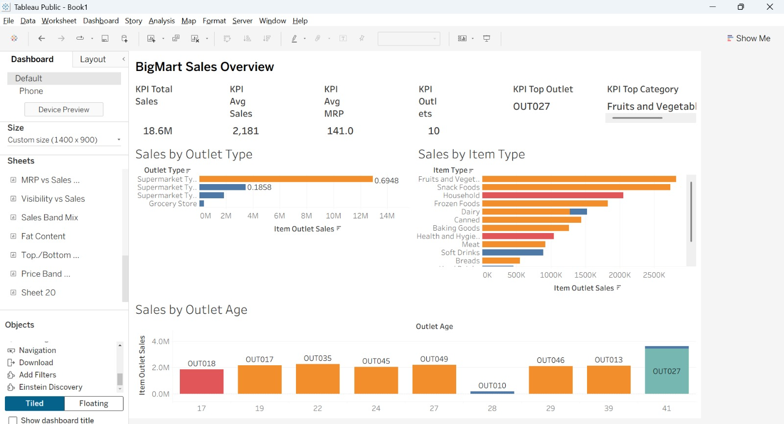
Sales Overview
DASHBOARD 1
What it shows
18.6M total sales across 10 outlets, with an average MRP of 141
Supermarket Type1 holds about 69% of sales and Type3 about 19%
Fruits and Vegetables and Snack Foods lead the item types
Why we chose it
KPIs summarize the business, and the bar charts compare store format, product mix and store age.
BigMart Sales Analytics · DAV Project
11
Notes:
The labels 0.6948 and 0.1858 on the outlet type chart are shares of total sales. The oldest outlet in the age chart, OUT027 at 41 years, is also the top outlet.

Slide 12
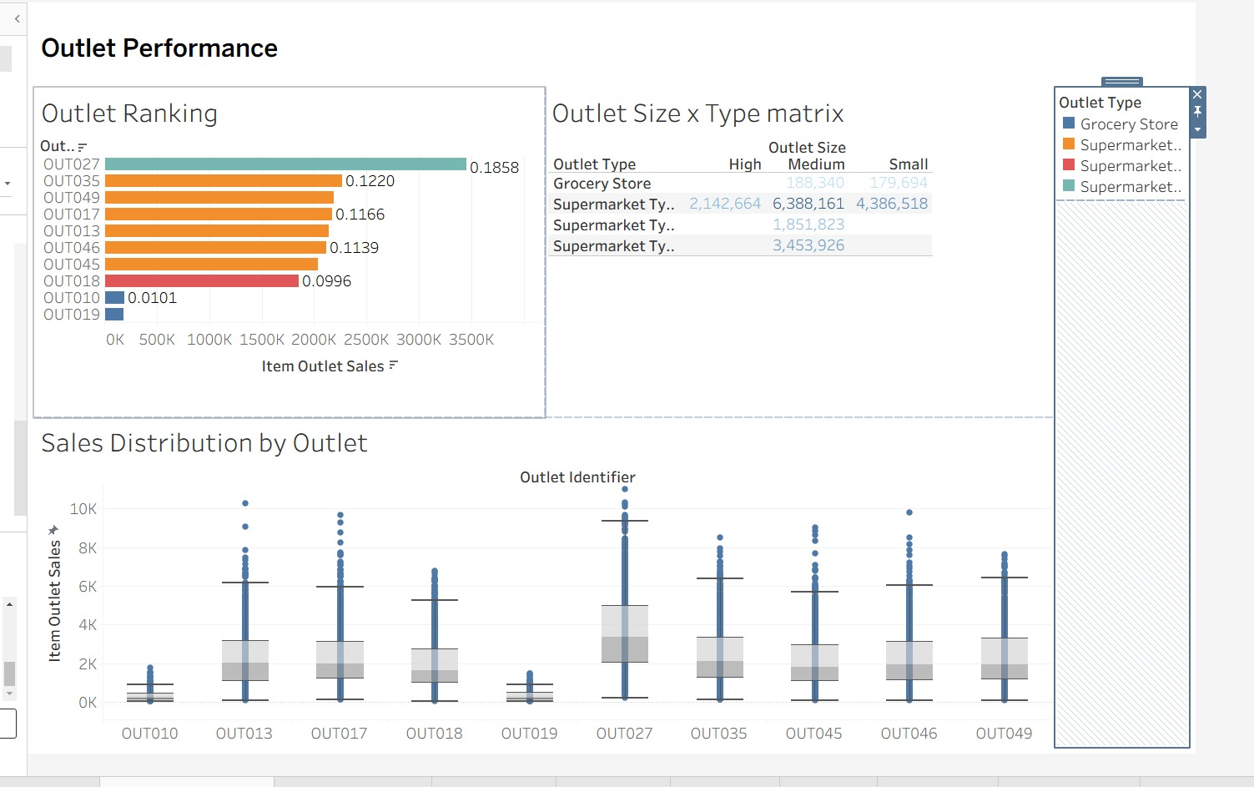
Outlet Performance
DASHBOARD 2
What it shows
OUT027 alone gives about 19% of sales; the two grocery stores give about 1% each
Medium Supermarket Type1 outlets total 6.4M, small ones 4.4M
OUT027 shows the widest spread, with sales near 10K
Why we chose it
Ranking shows who leads, the matrix separates size from format, and box plots show spread beyond totals.
BigMart Sales Analytics · DAV Project
12
Notes:
Ranking labels are shares of total sales. In the matrix, Supermarket Type1 medium outlets total about 6.39M, small about 4.39M and high about 2.14M, while grocery stores stay under 0.2M per size. The box plots show the distribution of individual item sales at each outlet.

Slide 13
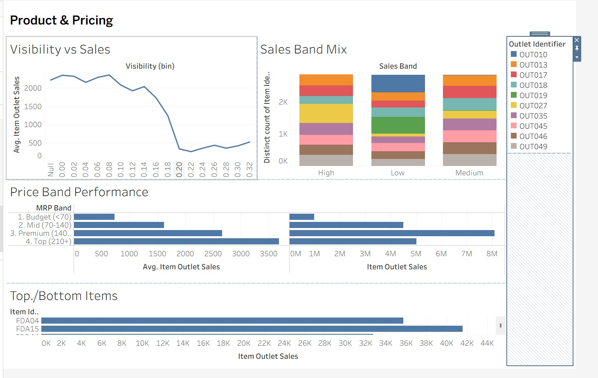
Product and Pricing
DASHBOARD 3
What it shows
Average sales fall sharply once visibility passes about 0.15, so more shelf space does not mean more sales
Average sales rise with price band; Premium (140 to 210) brings the most revenue
Grocery stores dominate the Low sales band
Why we chose it
These views test the product factors the models use: shelf space, price and performance bands.
BigMart Sales Analytics · DAV Project
13
Notes:
The visibility drop probably reflects outlet mix as much as shelf space, since grocery stores sell less overall; worth checking by filtering to one outlet type. The top items chart ranks individual products, led by FDA15 and FDA04.

Slide 14
What the data told us
KEY FINDINGS
69%
19%
~1%
56.4%
of sales come from Supermarket Type1 outlets
come from one outlet, OUT027, the top performer
is what each grocery store contributes
tier accuracy, against 33.3% for a random guess
Store format and price band matter most, while extra shelf visibility does not lift sales on its own.
BigMart Sales Analytics · DAV Project
14
Notes:
The percentages come from the Sales Overview and Outlet Performance dashboards. The classification accuracy comes from the KNIME Scorer.

Slide 15
Business value and next steps
CONCLUSION
How BigMart can use it
Next steps
Plan demand and reorders from predicted sales
Spot items likely to become low performers early
Match shelf space and pricing to what sells
Re-run the KNIME workflow on new sales files
Tune the Random Forest depth and tree count
Compare against XGBoost or LightGBM
Add residual plots and ROC curves
Impute visibility by item category
BigMart Sales Analytics · DAV Project
15
Notes:
Close by connecting the three parts: KNIME produced clean data and models, Tableau made the patterns visible, and together they support inventory, pricing and shelf-space decisions. Thank the audience and invite questions.

